Slide 1
IBD and IBS
Prof Arjuna De Silva
Professor in Medicine

Slide 2
Case I
25 Year old girl C/O abdominal pain and passing loose stools for the past 10 years.
Pain is relieved by defecation.
Lot of bloating
No loss of weight, no blood in stools However, passes mucous.
Is an accountant by profession.

Slide 3
Case 2
35 Year old man C/O passage of loose stools with abdominal pain for the past 5 years.
Loss of weight
Occasional passage of blood and mucous.
Mouth ulcers, back ache
Smoker , no alcohol

Slide 4
Inflammatory Bowel Disease (IBD)
This is a chronic disease of unknown
aetiology. Affecting mainly the
gastrointestinal tract. It can be divided
into two distinct phenotypes, Crohn’s
disease (CD) and Ulcerative colitis (UC)

Slide 5
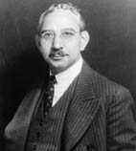
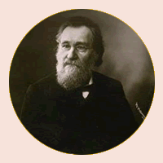
History
CD
Crohn, Ginsburg and
Oppenheimer in
1932.
UC
Samuel Wilks in 1859

Slide 6
Aetiology
Immunological
Environment
Genetic

Slide 7
Genetics-The evidence
Familial occurrence Kirstner 1963 UC
Twin studies
Genome wide scanning
- IBD 1 (Chrome 16 q 12)
- IBD 2 (Chromosome 12 q 13-15)
- IBD 3 (Chromosome 6 p)
- IBD 4 (Chromosome 14 q)
Now more than 100 !

Slide 8

Hugot JP, Chamaillard M, Zouali H, et al. Associationof NOD2 leucine-rich repeat variants with susceptibility to Crohn’s disease. Nature 2001;411:599–603.
Ogura Y, Bonen D, Inohara N, et al. A frameshift mutation in NOD2 associated with susceptibility to Crohn’s disease. Nature 2001;411:603–6.

Slide 9
Environmental
Hygiene hypothesis
De Silva HJ, De Silva NR, De Silva AP, Jewell DP
Emergence of inflammatory bowel disease 'beyond the West': do prosperity and improved hygiene have a role? Trans R Soc Trop Med Hyg. 2008 Sep;102(9):857-60
Appendicectomy , smoking
De Silva AP, Keragala SP, Hewawasm SP, Senanayake M, Kumarasena RS,Dassanayake AS, Pathmeswaran A, de Silva HJ.
The relationship between appendicectomy smoking and IBD among Sri Lankan patients UEGW2010
Gut Microbiota
This will be the key

Slide 10
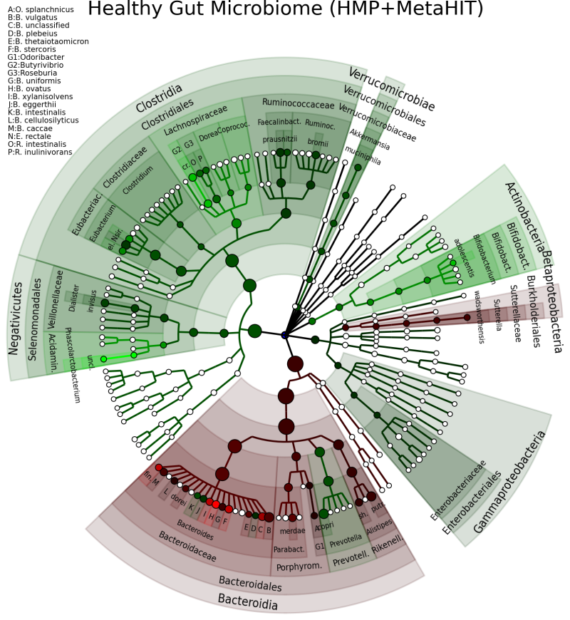
*

Slide 11
Prevalence
UK CD is 200/100000
Singapore UC 8.3/100,000
Sri Lanka UC 5.3/100,000
CD 1.2/100,000 *
Female predominance for UC (F:M=1.5:1)
*Niriella MA, De Silva AP, Dayaratne HGAK, Ariyasinghe M, Navarathne NMM, Peiris SKR, Samarasekara DN, Satharasinghe RL, Dassanayake AS, Wickramasinghe AR, de Silva HJ, Prevalence of inflammatory bowel disease in two districts of Sri Lanka: a hospital based survey. BMC Gastroenterol. 2010 Mar 19;10:32

Slide 12
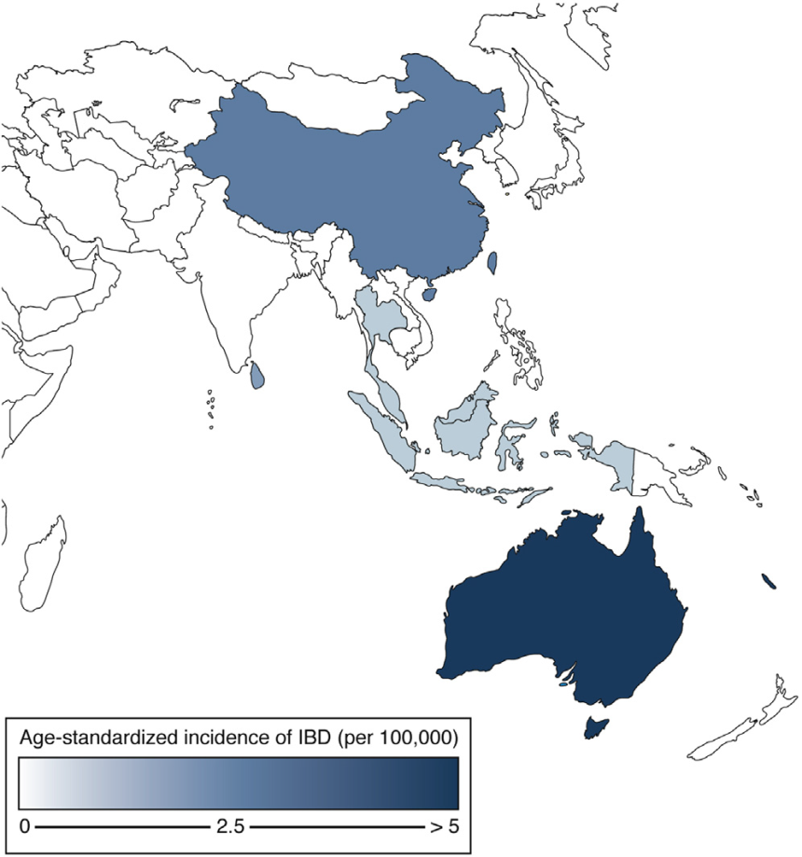
Incidence of IBD ACCESS study
 | Incidence (per 100,000)
 | IBD | CD | UC
Australia (Geelong) | 23.7 | 14.0 | 7.4
Hong Kong | 3.1 | 1.3 | 1.7
China (Guangzhou) | 2.4 | 1.0 | 1.4
Macau | 2.2 | 1.0 | 0.6
Sri Lanka (Gampaha) | 1.6 | 0.6 | 1.0
Singapore | 1.1 | 0.4 | 0.6
Malaysia (Ipoh) | 0.9 | 0.2 | 0.6
Indonesia (Jakarta) | 0.9 | 0.3 | 0.6
Thailand (Bangkok) | 0.6 | 0.3 | 0.3
China (Chengdu) | 0.6 | 0.3 | 0.4
China (Xian) | 0.5 | 0.1 | 0.4

Slide 13
Ulcerative colitis
Ulcerative colitis is characterized by of inflammation limited to the mucosal layer of the colon.
It almost invariably involves the rectum and may extend in a proximal and continuous fashion to involve other portions of the colon.
Different terms are used to described the degree of involvement.

Slide 14
UC
Ulcerative proctitis refers to disease limited to the rectum.
Distal colitis or proctosigmoiditis is used when the inflammatory process extends into the mid-sigmoid colon, usually reachable by the 60 cm flexible sigmoidoscope.
Left-sided ulcerative colitis is defined as disease that extends to the splenic flexure.
Pancolitis is used when the inflammatory process extends beyond the splenic flexure even though many of these patients will not have inflammatory bowel disease to the cecum.

Slide 15
CD
In contrast to ulcerative colitis, Crohn's disease is characterized by transmural rather than superficial mucosal inflammation and by skip lesions rather than continuous disease.
The transmural inflammatory nature of Crohn's disease often leads to fibrosis and to obstructive clinical presentations which are not typically seen in ulcerative colitis.
The transmural inflammation can also result in sinus tracts that burrow through and penetrate the serosa, giving rise to microperforations and fistulae.

Slide 16
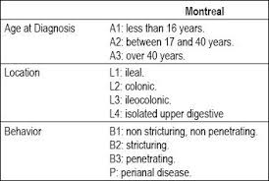

Slide 17
Investigations
Colonoscopy
Barium
Enteroscopy
Capsule
MRI
CT

Slide 18
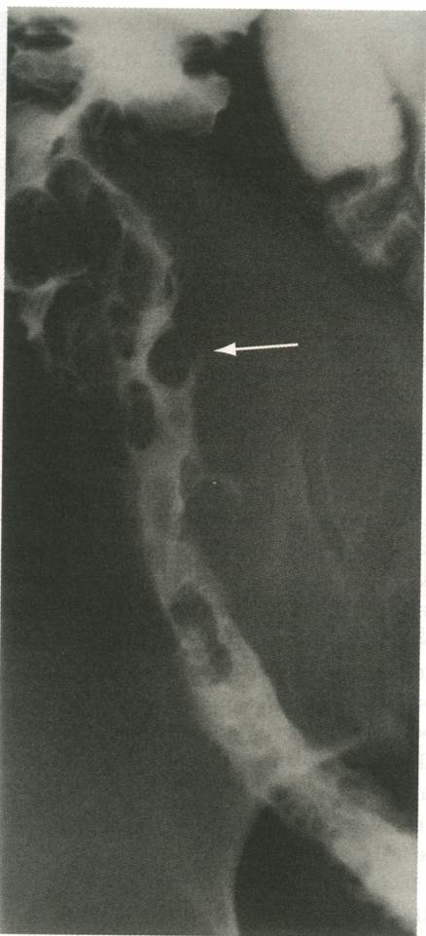
Barium meal and follow though

Slide 19
Diagnosis
History
Examination
Colonoscopy
Histology

Slide 20
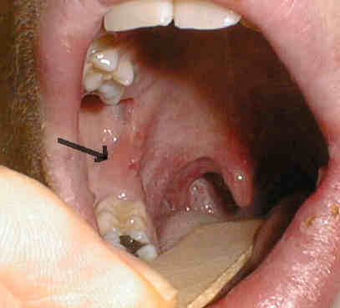

The differences
CD
UC
Sclerosing cholangitis

Slide 21
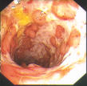
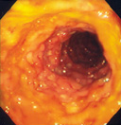
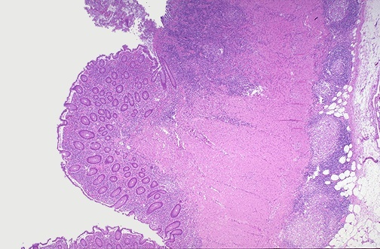
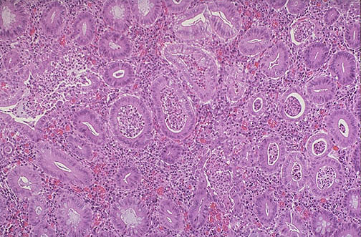
The differences (cont)
CD
UC

Slide 22
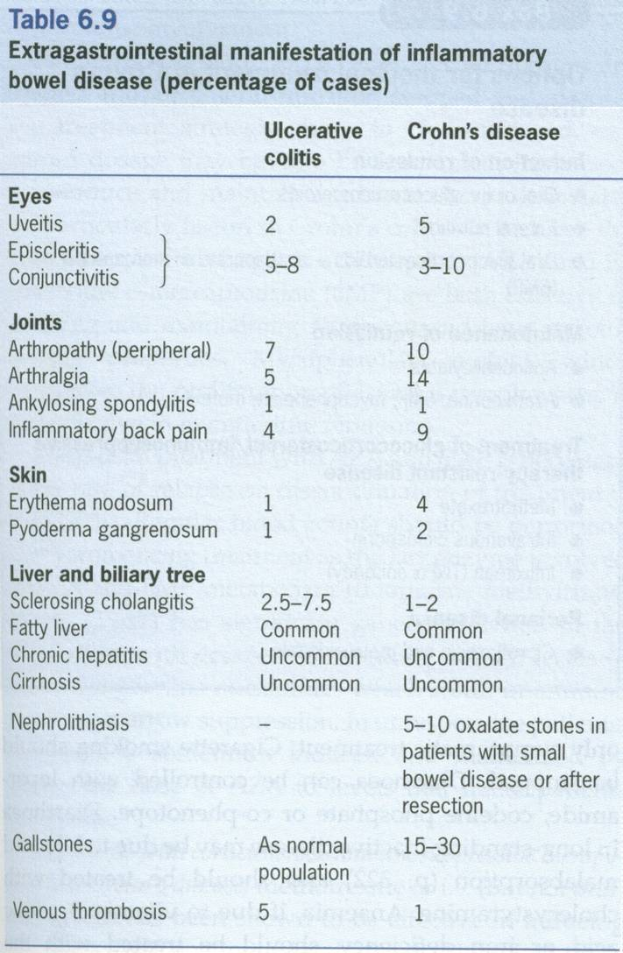
Extra intestinal manifestations

Slide 23
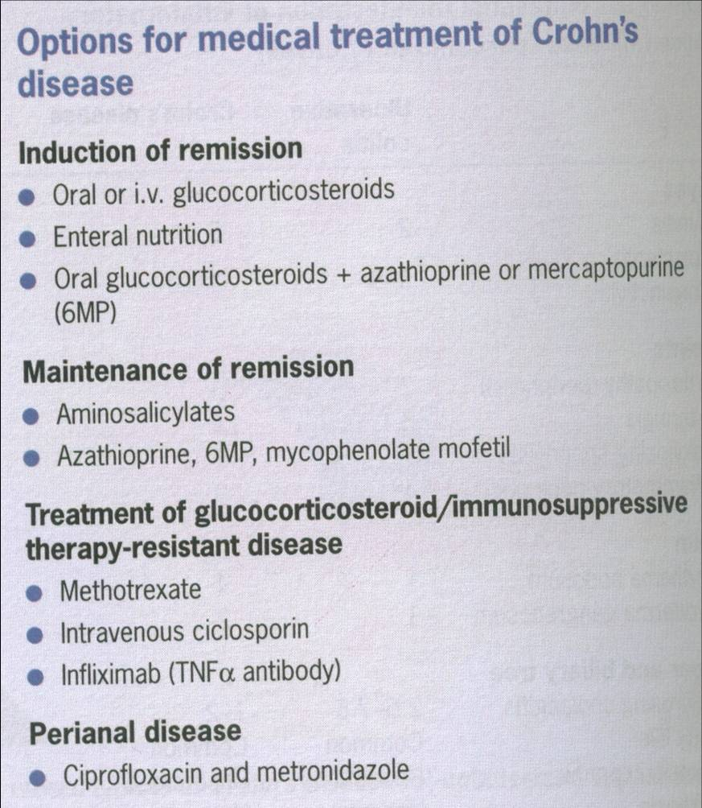
CD Management

Slide 24
CD management
Other biologics
Anti TNF
Adalimumab
Certolimumab
-α4, 7 integrin blocker
Vedolizumab
-Anti IL 12/23
Ustekinumab

Slide 25
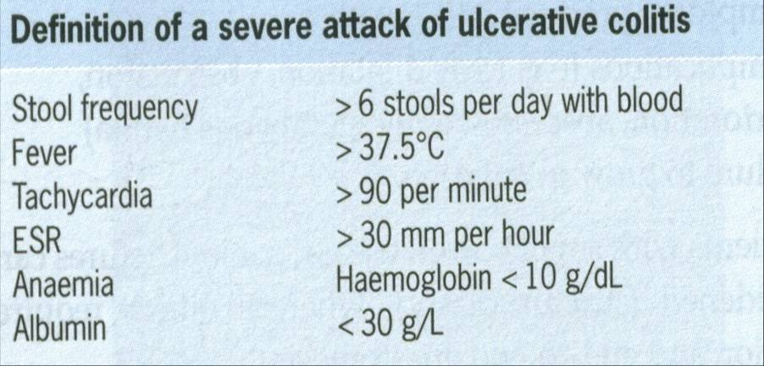
Management UC

Slide 26
UC management
Remission induction
IV steroids 100mg 6 hr /oral
IV cyclosporine
IV infliximab
Maintenance
Sulphasalazine
6MP
Mesalamine
Azathioprine

Slide 27
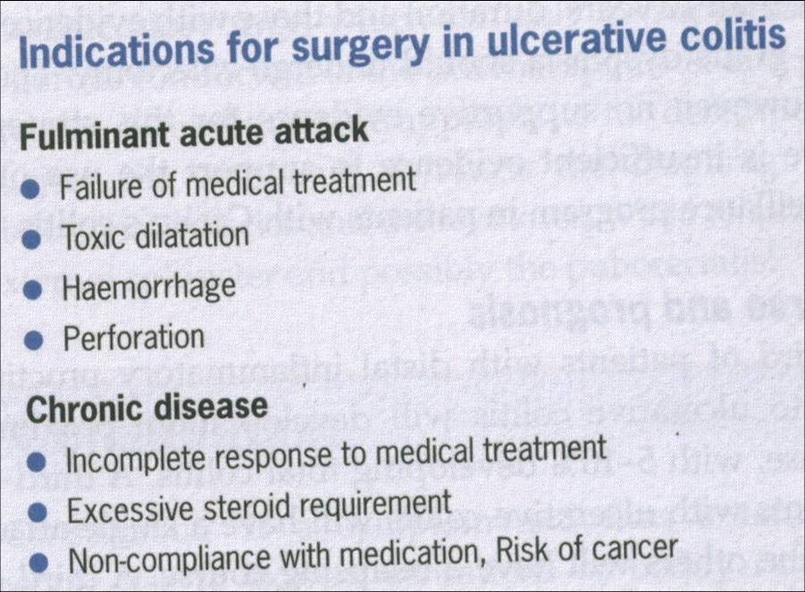
UC Surgery

Slide 28
UC surgery
Ileoanal pouch operation
Very good quality of life
Pouchitis is a problem

Slide 29
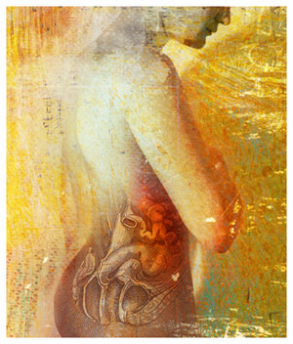

Slide 30
History
The term IBS was first coined by Peters and Bargen
Was a diagnosis of exclusion
Manning criteria (1978)
Rome II (1999)
Rome III(2006)

Slide 31
Rome III Functional Gastrointestinal Disorders
A. Functional oesophageal disorders
B. Functional gastroduodenal disosrders
C. Functional bowel disorders
D Functional abdominal pain
E Functional gallbladder and Sphincter of Oddi (SO) disorders
F Functional anorectal disorders
G Functional disorders: neonates and toddlers
H Functional disorders: children and adolescents

Slide 32
IBS
C1. Diagnostic Criteria* for Irritable Bowel
Syndrome
Recurrent abdominal pain or discomfort**
least 3 days per month in the last 3 months
associated with 2 or more of the following:
Improvement with defecation
Onset associated with a change in frequency of
stool
Onset associated with a change in form (appearance)
of stool
Criteria fulfilled for the last 3 months with symptom onset
6 months prior to diagnosis.
Discomfort means an uncomfortable sensation not
described as pain. In pathophysiology research and
trials, a pain/discomfort frequency of at least 2
week during screening evaluation for subject
eligibility.

Slide 33
Symptoms that cumulatively support the diagnosis of IBS
Abnormal stool frequency ( <3/ wk or >3/day )
Abnormal stool form
Abnormal stool passage
Passage of mucus

Slide 34
Table 2. Subtyping IBS by Predominant Stool Pattern
1. IBS with constipation (IBS-C)—hard or lumpy stoolsa 25% and
loose (mushy) or watery stoolsb 25% of bowel movements.c
2. IBS with diarrhea (IBS-D)—loose (mushy) or watery stoolsb
25% and hard or lumpy stoola 25% of bowel movements.c
3. Mixed IBS (IBS-M)—hard or lumpy stoolsa 25% and loose
(mushy) or watery stoolsb 25% of bowel movements.c
4. Unsubtyped IBS—insufficient abnormality of stool consistency to
meet criteria for IBS-C, D, or M.

Slide 35
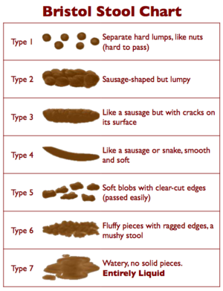

Slide 36
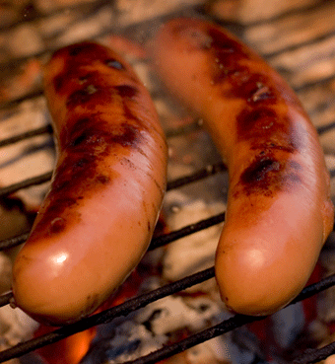

Slide 37
Epidemiology
Prevalence of up to 20% in western countries
Female preponderance in western countries
Male preponderance in India and Sri Lanka

Slide 38
Diagnosis
Diagnosis is clinical
Basic test can be done (ie stools FR, ESR,TSH, anti-endomyceal anti body)
Colonoscopy only is diagnosis is in doubt or alarm symptoms

Slide 39
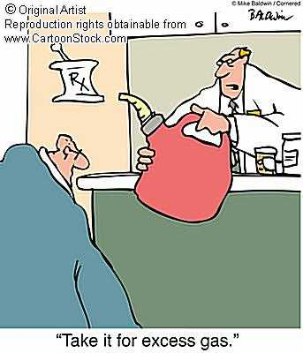
Magement
Management

Slide 40
Management
IBS with Diarrhoea
Dietary (avoid legumes, excess fiber)
Loperamide (2-8 mg)
Codein phosphate (30 – 90mg )
Amitriptyline (12.5 – 25 mg)
Alosetron

Slide 41
Management (cont)
Constipation predominant
Dietary (increased roughage)
Lactulose,
Tegaserod 6mg bid (now withdrawn)
Lubiprostone

Slide 42
Management of Pain and bloating
Anti spasmodics
Mebervarine
Pepermint oil
Antidepressants
Amitryptyline
Fluoxetine
Relaxation therapy and biofeedback

Slide 43
IBS in Sri Lanka
30 patients with diarrhoea predominant IBS (diagnosed using ROME II), No alarm symptoms, CRP & TSH normal
11 controls (age and sex matched)
Colonoscoped and serial biopsies taken from ileum onwards

Slide 44
Results
CASES CONTROLS p Value
Number 30 11
Male: Female 19: 11 5: 6
Mean age (yrs) 37.5 42.5
Histology MNOS(%) 17(57) 2(18) 0.02
Ieal inflammation 1(5) 0(0)
Normal 12(38) 9(82)
AP De Silva ¹, A S Dassanayake ², J Hewavisenthie ³, CS Munasinghe¹,TKMP Karunanayaka¹,DLMN Liyanage¹, HJ de Silva¹
Microscopic colitis not otherwise specified (NOS) in patients with diarrhoea predominant IBS in a tropical setting. Gastroenterology 2007; 132: S1195

Slide 45
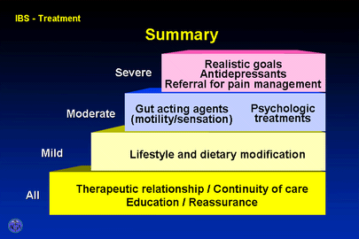
Management

Slide 46
Summary
The rule of “3”
Rome III
3 months symptoms, 3,times a month onset 3×2months
More than 3 motions a day diarrhoea, less than 3 motions per day constipation
3 alarm symptoms (age >50, wt loss, bleeding)
3 signs (pale, palpable masses, PR)
3 drugs (anti-diarrhoeals, laxatives, antispasmodics )
3 investigations ( CRP/ESR, USS, Endoscopy/Colonoscopy

